Slide 1
Challenge Name
Team Name

Slide 2
Presenting info to the entire team
OUR THEME:

Slide 3
Our Innovations
Highly maneuverable
Sensors
LiDAR
Battery life
On Board Analysis
Propellers
Gimbels

Slide 4
Initial research
Things we ruled out and moved past
Things to expand and focus on

Slide 5
Subsystems
Electronics
Structure
PROPELLERS
Computers Power Motor Systems
Airframe Shape Materials Design
Placement propeller type

Slide 6
Frame and Structure
Materials:
Carbon Fiber: Ideal for lightweight, high-stress parts.
Aluminum Alloys: Cost-effective, widely used but prone to corrosion.
Titanium: High strength, corrosion resistance, suitable for critical components.
Shape:
H shape: Ideal for heavy payload drones
X shape: Combination of stability, agility, durability, and versatility
N number of branches: Variable use cases for for speed or stability and can be modified as seen fit

Slide 7
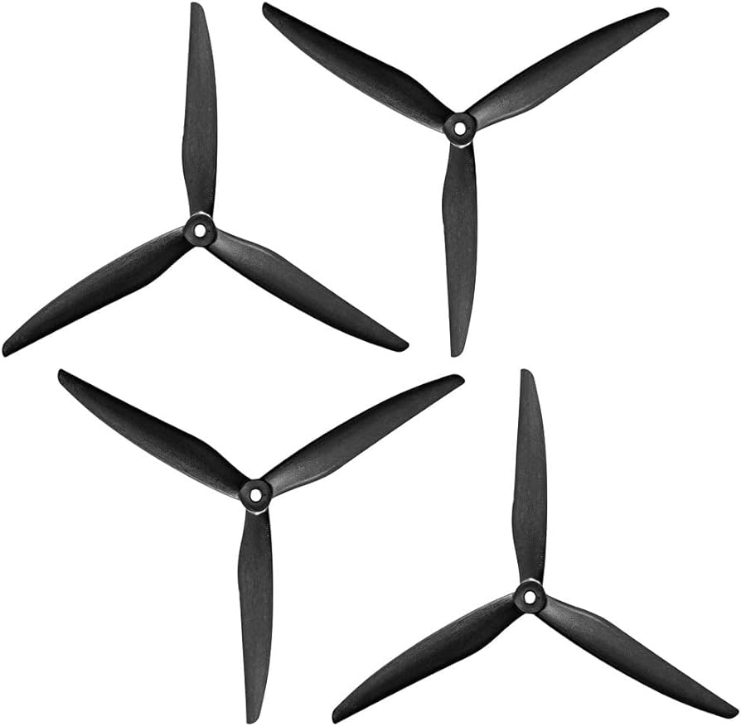
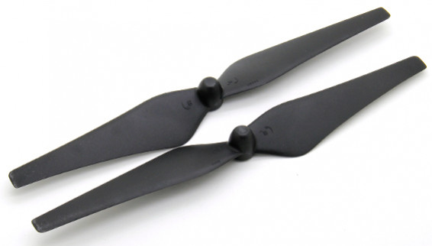
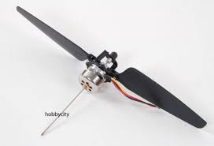
Propellers
Propeller designs:
Tri-blade - allows for increased hover stability and thrust generation
Two blade - cheapest option and common, but average elsewhere
Variable pitch - able to adjust pitch of the blades to change stability and thrust depending on needs
Cross arm designs:
Square - allows for the greatest thrust production while the quadcopter is hovering, at the expense of increased drage while in motion
Circular - decreased weight while maintaining a high stress and strain

Slide 8
Any Completed Trade studies

